Slide 1
From IT Helpdesk to Senior Sysadmin
A practical career journey from IT Helpdesk to Senior Sysadmin and the first steps toward Cloud and DevOps.
Tran Trung Vinh
System Administrator at Central Retail Group

Slide 2
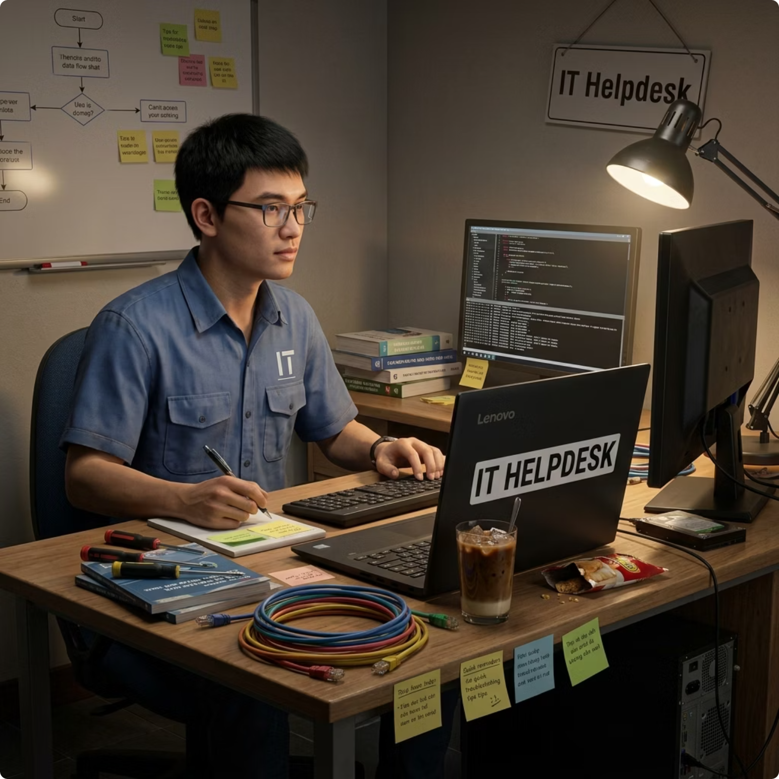

This is not a story about extraordinary success
I started my career in IT Helpdesk without a degree from a top university or any special advantages. Like many young professionals, I was once unsure about my career path.
This talk shares real experiences, challenges, self-learning efforts, and practical lessons from working in IT infrastructure.
For: Students, Freshers, Helpdesk & Junior Sysadmins

Slide 3
Agenda
01
02
From IT Helpdesk to Sysadmin
Life as a System Administrator
Starting point, key skills, and career milestones
Daily responsibilities, operational mindset and lessons learned from incidents
03
04
My First Cloud Journey & Transition to DevOps
My Central Retail Group Interview Journey
Cloud wasn't just a new technology. It was a new way of thinking.
Application process, interviews, and lessons learned
05
06
Lessons & Advice
Connect With Me
Common mistakes, growth strategies, and practical recommendations
LinkedIn, networking, and further discussions

Slide 4
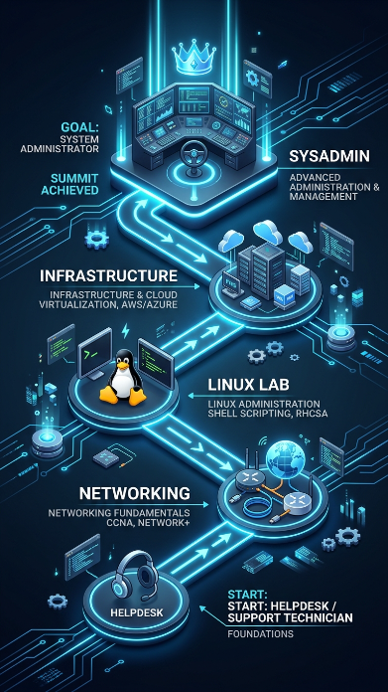
From IT Helpdesk to Sysadmin
Skills from Helpdesk
Turning Point
Troubleshooting under pressure
Communication with end users
Problem-solving mindset
Understanding how IT systems work
Learning Linux and Networking
Building hands-on lab environments
Exploring Infrastructure Technologies
Preparing for a Sysadmin role
Key Realization
I didn't want to just support systems. I wanted to understand how they were built.

Slide 5
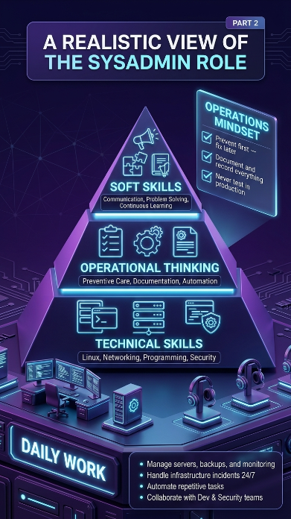
Life as a System Admin
Beyond Servers
Key Lessons
Server provisioning & maintenance
Network infrastructure management
Security patching & updates
Capacity planning & monitoring
Automate repetitive task to save time
Document configuration and runbooks
Implement monitoring before incidents happen
Build strong relationships with dev team
Key Realization
Never test in production – protect availability, trust and your team’s time

Slide 6
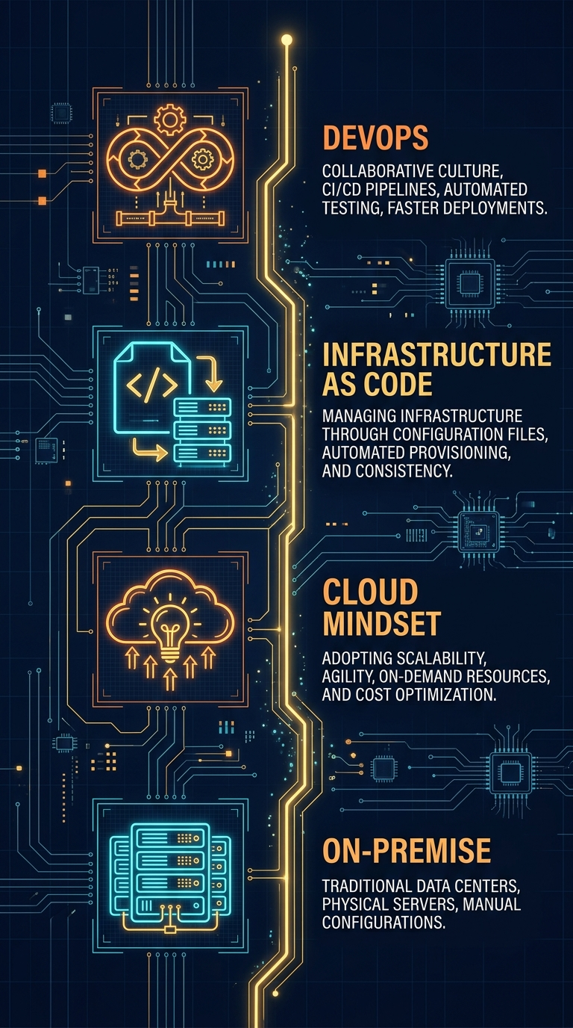


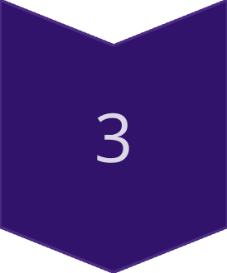
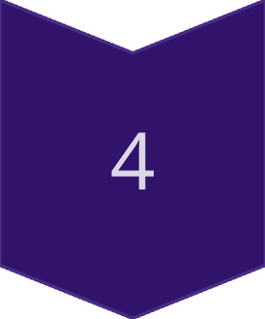
First Cloud Journey — From Sysadmin to Cloud/DevOps
On-Premise
Managing physical servers, manual configuration, manual scaling
Cloud Mindset
AWS, elastic scaling, pay-as-you-go, managed services
Infrastructure as Code
Terraform, version control, repeatable deployments
DevOps Culture
CI/CD, Docker, automation, collaboration with Dev

Slide 7
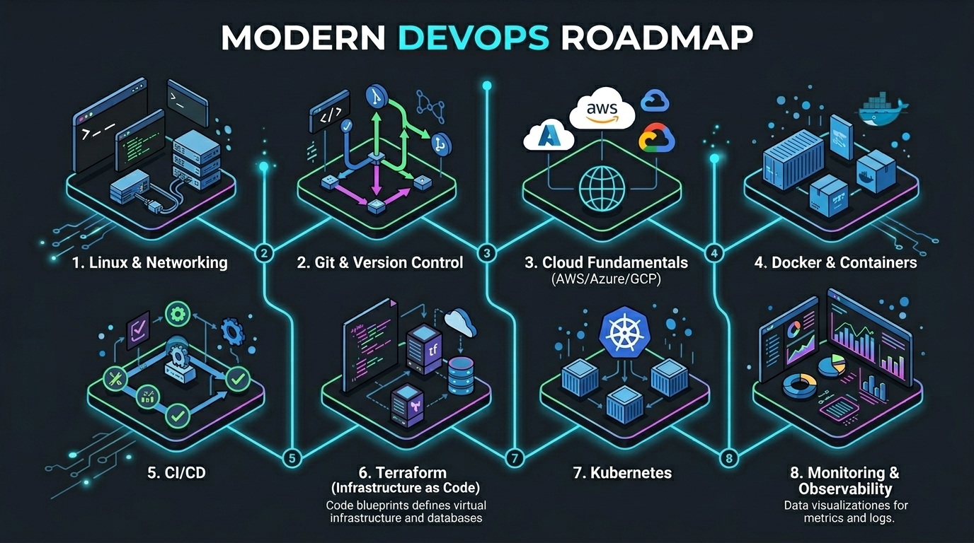

Slide 8





My Interview Journey with Central Retail Group
Preparation
Focus on real projects and achievements
Highlight practical skills and experience
Before the Interview
Research the company and its technology landscape
Understand the business and technical challenges
Technical Assessment
Architecture design
Incident response scenarios
Troubleshooting exercises
Key Lesson
Practical experience is your strongest advantage.

Slide 9




Lessons & Career Advice
Common Mistakes
Building Capability
Learning too many things at once
Not practicing enough
Avoiding question
Being afraid to fail
Go deep on 1-2 core first
Build real projects and hand-on experience
A real portfolio matters more than certification
Final Message
Where you start don’t matter - keep going. Every small step counts.

Slide 10
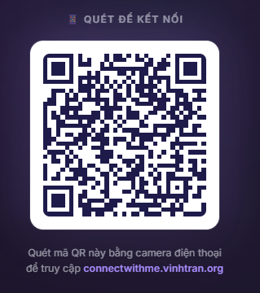
CONNECT WITH ME

